Slide 1
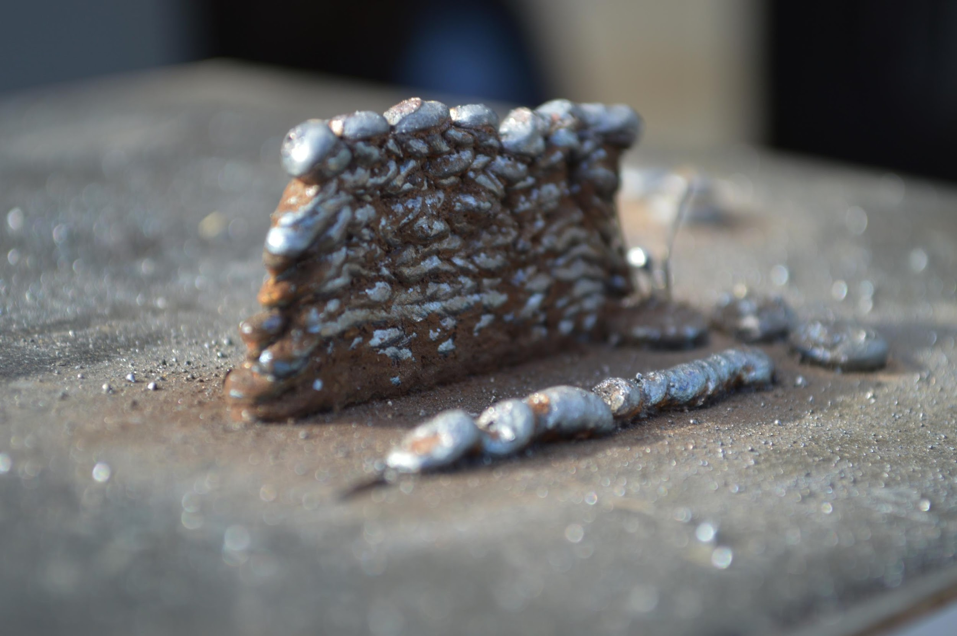
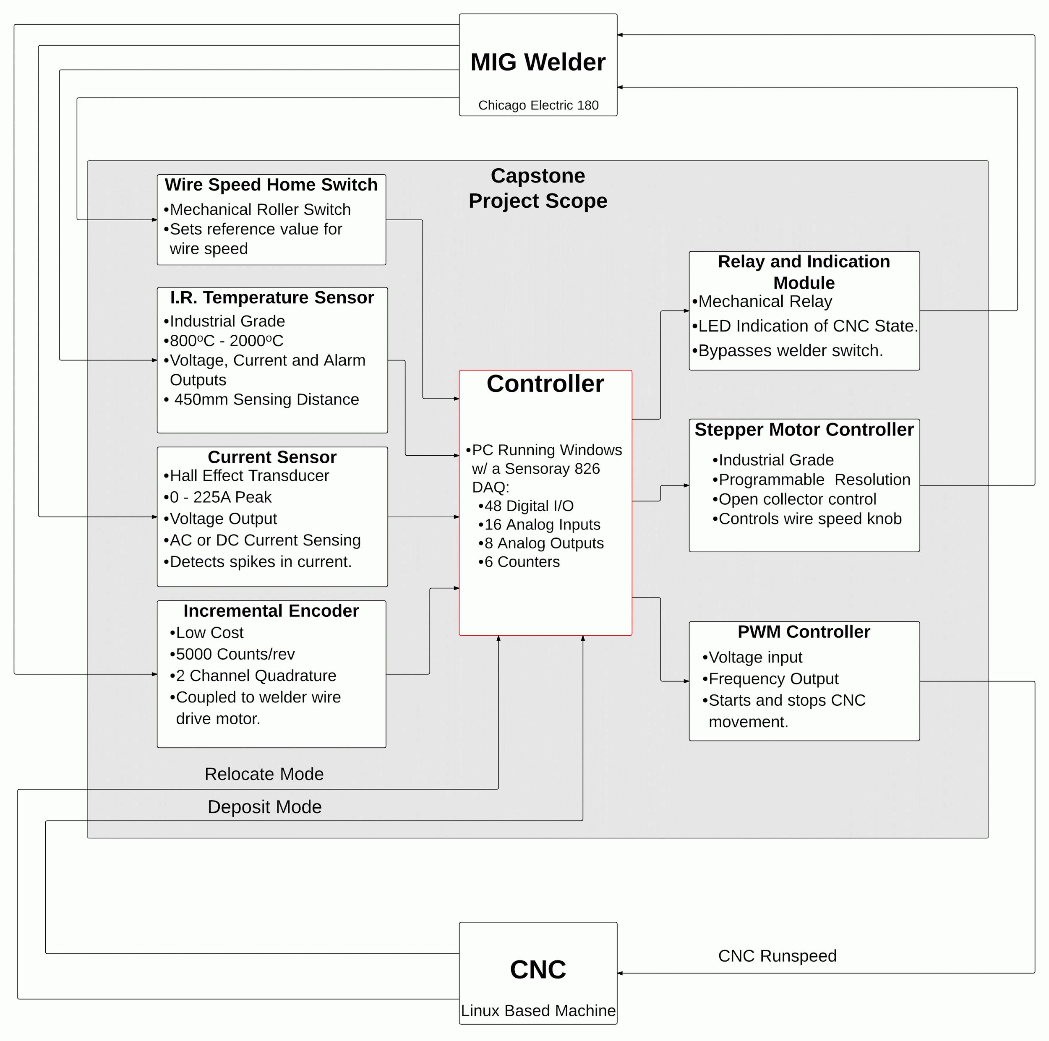
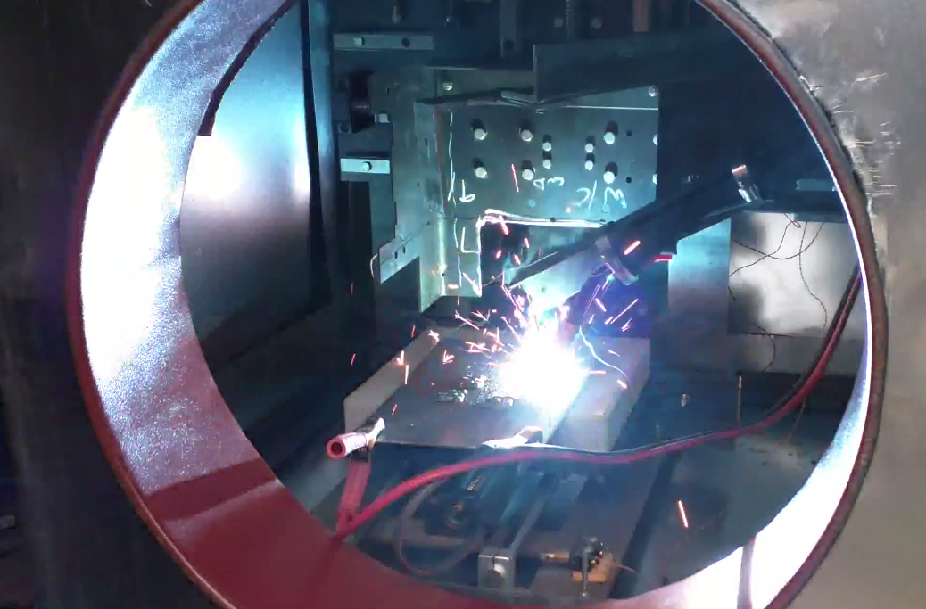


3D Metal Printing
Industry Sponsor – Aram Kasparov
Team Members – Brian Andrews, Branden Driver, Cameron Tribe, Ahmad Qazi
Faculty Advisor – Marek Perkowski
Project and Motivation
The purpose of this project is to create a faster, cost-effective alternative to current metal casting processes. The project goal is to create a 3D metal printer that is capable of quickly creating metal components at a lower cost. Our objective is proof-of-concept for future exploration, creating highly precise parts is beyond the scope of this project.
A Metal Inert Gas (MIG) welder is combined with a Computer Numerical Control (CNC) machine more typically used for computer-aided machining of metal parts, as seen in Figure 1. Welding wire is fed through the nozzle of the MIG welder, creating the weld pool. The CNC is programmed to precisely position the MIG for accurate deposition (“printing”). Building upon previous layers of deposition, a 3D object will be printed.
Goals
Interface the MIG welder with CNC machine.
Determine quality of deposition based on temperature and current.
Control the MIG welder based on quality of deposition.
Allow for future expandability
Control System
Control of the system is done using a PCI Express DAQ board from Sensoray CO Inc. The controller receives inputs from 4 sensors that monitor the deposition. Based on these inputs, the controller will adjust wire feed speed to ensure a quality deposition. If at any point an error occurs, the system will pause and wait for corrections to be made.
Project Outcomes
The following outcomes were successfully completed:
Selected a controller that minimized limitations of future expansion.
Accurately measured speed of wire leaving the welder.
Created a system that dynamically calculates and controls the wire feed rate.
Determined welder settings in correlation with CNC settings to achieve a quality weld.
Created a homing and calibration procedure for the welder settings.
Controlled the temperature of the plate being welded to via feedback from the temperature sensor.
Fig 3. Z-axis Deposition Testing
Fig 1. System in Deposition Mode
Fig 2. Block Diagram of System
Fig 4. Shape Deposition Testing
A special thanks to Jim Lamberson at Sensoray
Department of Electrical and Computer Engineering

